Slide 1
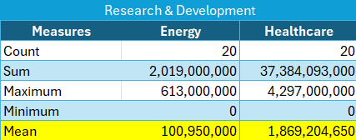
Are The Costs Spent on Research and Development by The Healthcare and Energy Sectors Similar?
The average costs spent on research and development by the companies under the healthcare sector is equal to $1,869,204,650 which is much higher than the average costs spent on research and development by the companies under the energy sector which is $100,950,000.
It seems that companies belonging to the healthcare sector have a higher average in costs spent on research and development than the companies belonging to the energy sector

Slide 2
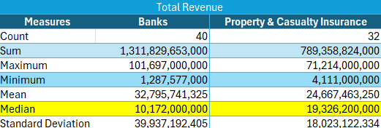
Is The Total Revenue Earned by Banks and Property and Casualty Insurance Companies Within The Financials Sector Similar
The median total revenue for Banks under the Financials sector ($10,172,000,000) was lower compared to the total revenue for the Property & Casualty Insurance companies ($19,326,200,000).
It looks like 50% of the Casualty & Insurance companies in the sector have a higher total revenue on average than 50% of the Banks.

Slide 3
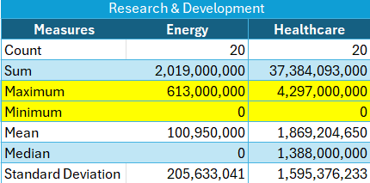
How Much Are The Companies Under The Healthcare and Energy Sectors Willing to Spend on The Research and Development Costs
The range of costs spent on research and development by the companies under the healthcare sector is equal to $4,297,000,000 which is much higher than the range of costs spent on research and development by the companies under the energy sector which is $613,000,000.
It seems that companies belonging to the healthcare sector have a higher variability in the costs spent on research and development than the companies belonging to the energy sector because the range is high, allowing for more diversity.

Slide 4
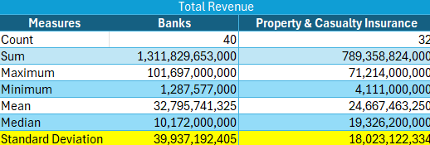
Average Change of Returns for Banks
Banks have a standard deviation of total revenue that equals to $39,937,192,405.
It means that the average change of returns for the Banks is $39,937,192,405.

Slide 5
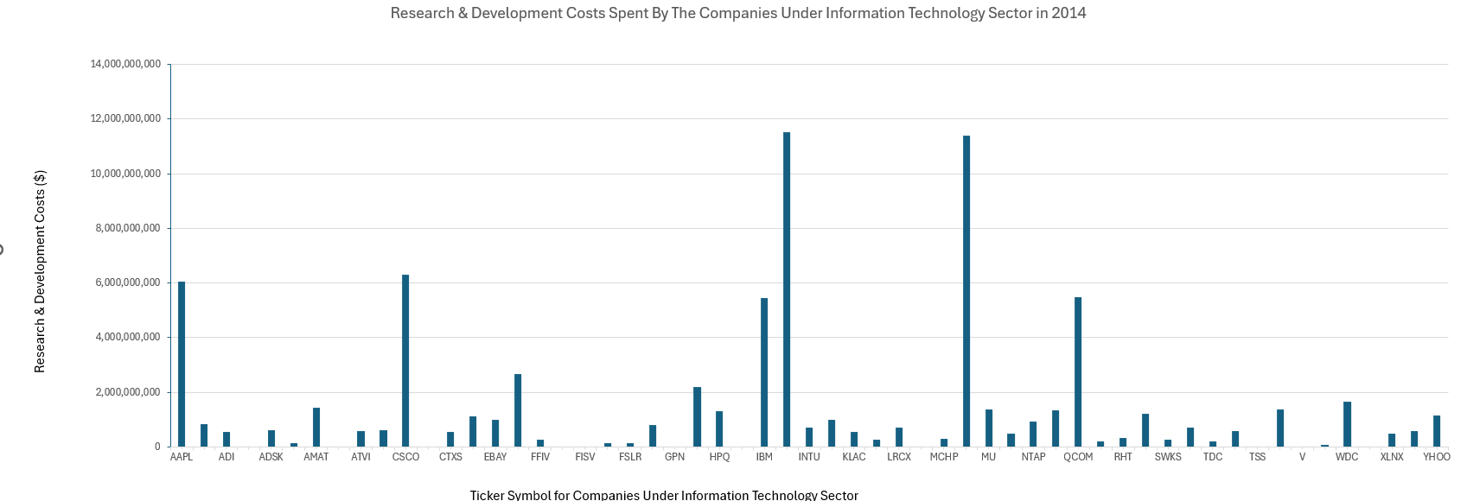
Research & Development Costs Under IT Sector in 2014

